Slide 1
Would you rather fight, without weapons, 10 chicken-sized gorillas or 1 gorilla-sized chicken?

Slide 2
Communicating Research with Effective Storytelling
AFS2024 Workshop - Day 2
Megumi Oshima & Pavel Dimens

Slide 3
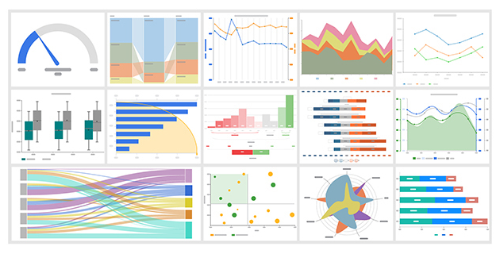
Information
facts
facts, but pictures

Slide 4
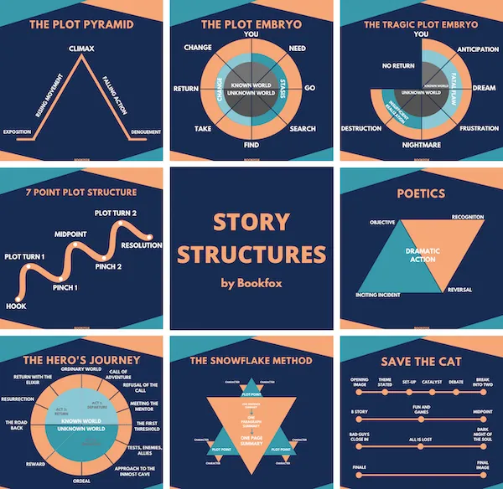
Story
introduction
setting
characters
direction
conflict to resolve

Slide 5
Story about information
introduction
setting
characters
direction
conflict to resolve
where are we
what are we doing
what are we looking at
It’s just worldbuilding ground us

Slide 6
Story
introduction
setting
characters
direction
conflict to resolve
why are you bothering
why should we care
convince us this is cool or important

Slide 7
Story
introduction
setting
characters
direction
conflict to resolve
we need to go somewhere

Slide 8
Direction

Slide 9
Direction
The setup
The rationale
What you did
How it went
Ok cool, what now?
linear flow

Slide 10

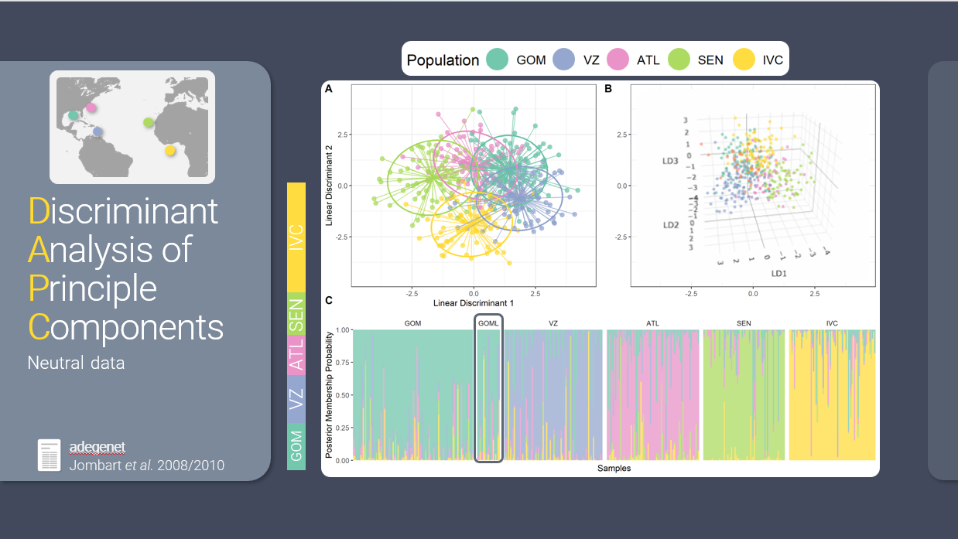
flow
visual
auditory

Slide 11
Exercise

Slide 12

floooooooooow
sound is a stream
sight is a shotgun

Slide 13
5 Minute Break

Slide 14

✨Aesthetics ✨
Keep an audience’s interest for technical topics
A chance to add some personality
Notes:
Less text
Slide Master
Insert Icons

Slide 15
Fonts
sans serif vs serif
Size
Mix n’ match for emphasis
Google Fonts
Notes:
Choose a sans serif font option over a serif
Make sure the font size (on everything) is large enough for an audience to read in a large room
Can have a main font and then use a different one for emphasis or accent
Resources like google fonts have a lot of different fonts you can download and use for free

Slide 16
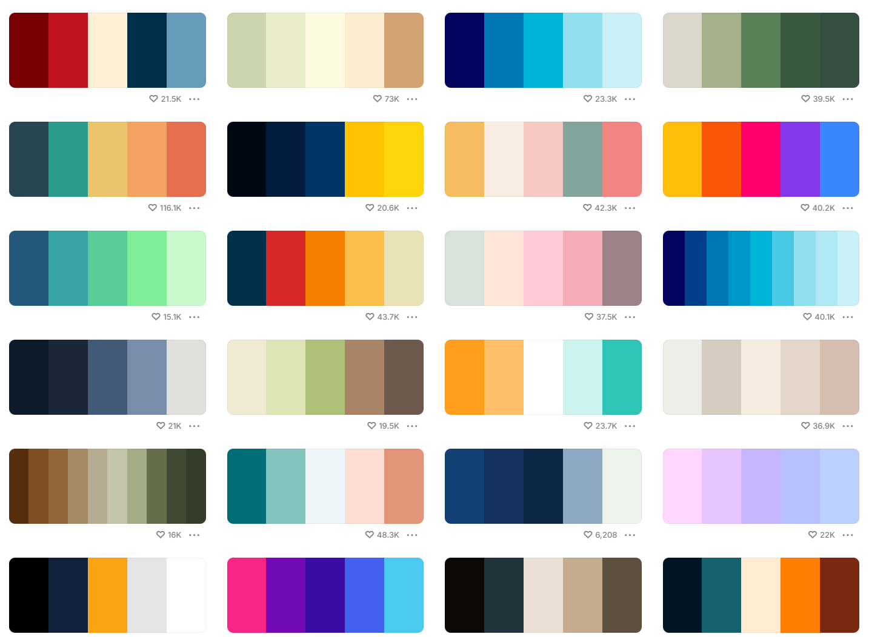
Colors
consistent
cohesive
beyond the defaults
coolors
Notes:
Creating a color palette to use throughout your talk can give it a really nice cohesive feel. Powerpoint’s defaults have improved over time but to really make your presentation stand out, create your own. You want to make sure your color palette is pleasing (not all bright vivid colors that are harsh on the eyes and hard to see) and accessible. You can get inspiration from anything, just a quick google for color palette or use resources like coolors to find pre-made palettes or create your own.

Slide 17
Less text
Use a consistent color palette throughout the presentation, and match those colors in figures and graphs.
Create cohesive color palettes that look good and are accessible.
Look for inspiration online or at pre-made palettes.

Slide 18
Less text
Use a consistent color palette throughout the presentation, and match those colors in figures and graphs.
Create cohesive color palettes that look good and are accessible.
Look for inspiration online or at pre-made palettes.

Slide 19
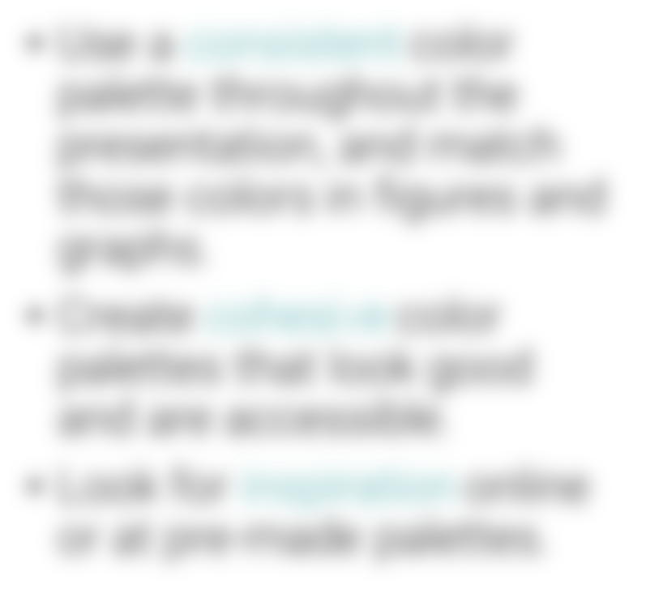
Less text
Consistent
Cohesive
Beyond the defaults

Slide 20

Use icons
we measured fish lengths
we aged fish otoliths
we collected stomach contents
we collected gonads
we measured fish lengths
we aged fish otoliths
we collected stomach contents
we collected gonads

Slide 21
Use icons
Tuna Species | Number tagged | Max Depth (m)
T. thynnus | 5 | 502
T. albacares | 4 | 458

Slide 22

Use icons
Number tagged
Max Depth (m)
5
502
4
458

Slide 23
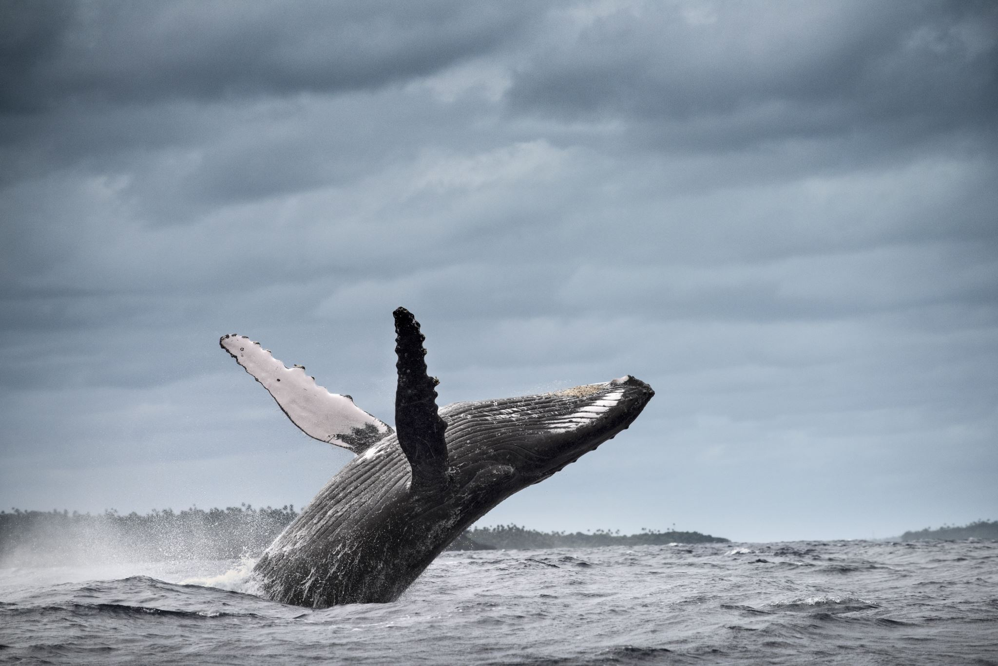
Make your images dimensional

Slide 24
Make your images dimensional
Rounded corners

Slide 25
Make your images dimensional
Rounded corners
Add a drop shadow

Slide 26
Make your images dimensional
Rounded corners
Add a drop shadow
Give it a background

Slide 27
Make your images dimensional
Rounded corners
Add a drop shadow
Give it a background
Change the shape

Slide 28
Exercise

Slide 29
5 Minute Break

Slide 30
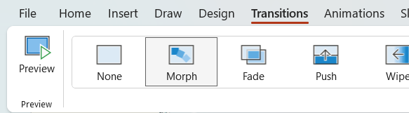
Behold: Morph

Slide 31
Topic Title

Slide 32
Topic Title

Slide 33
Second Topic

Slide 34
Third Topic

Slide 35
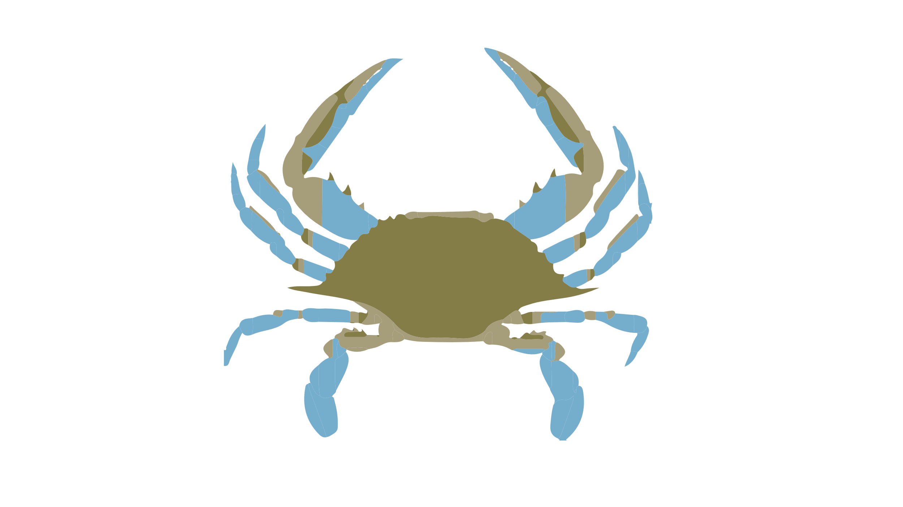
Here are facts
Is this big
Likes to do this
Likes to go here
Hates paprika
Nihilistic
Cyberbully

Slide 36
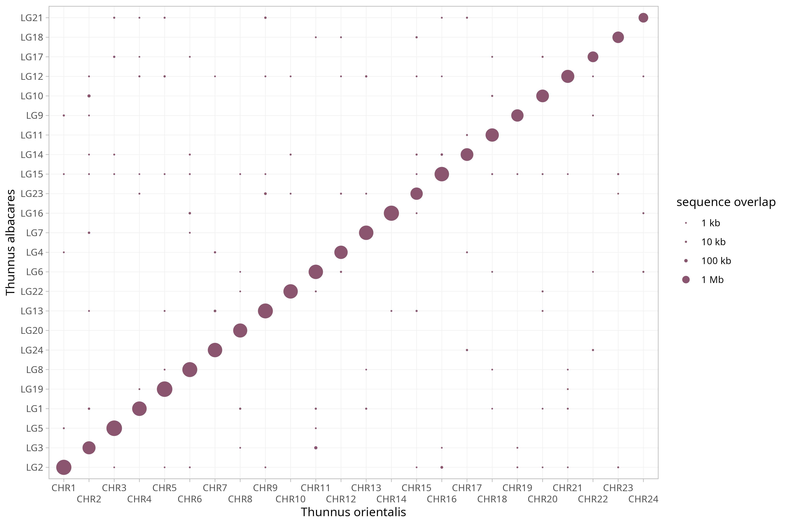
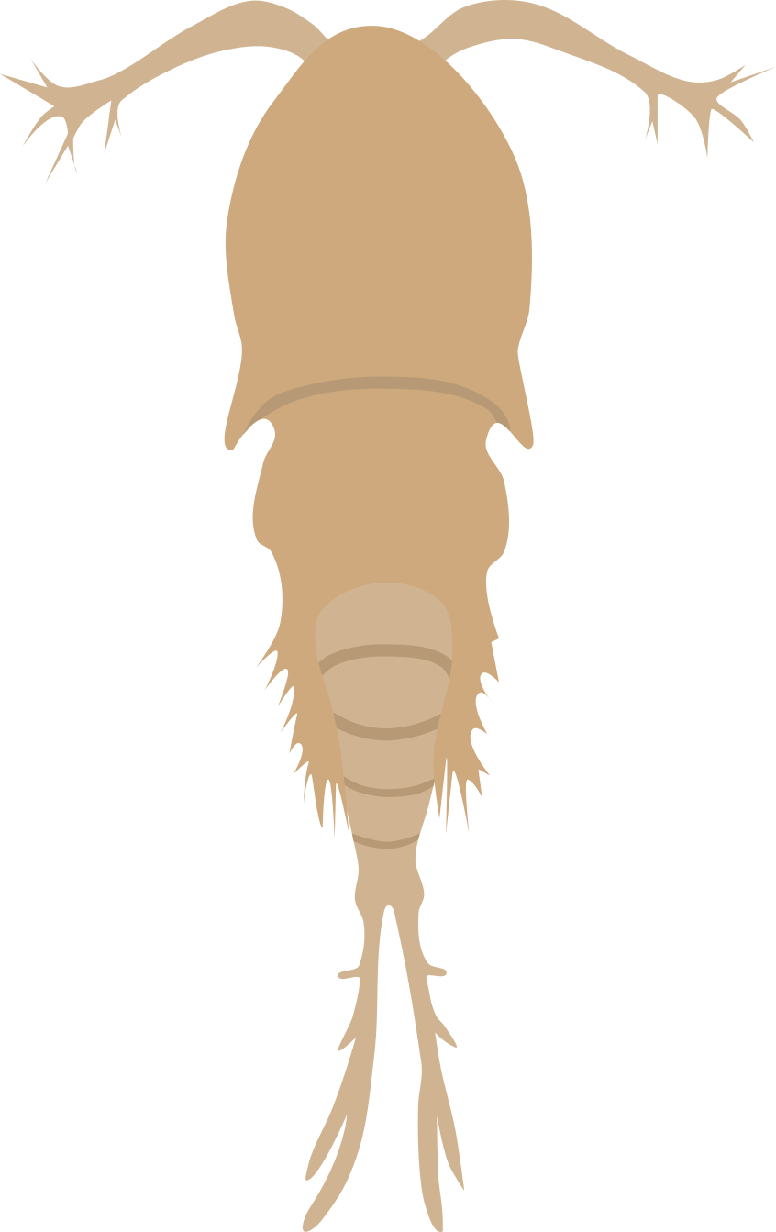
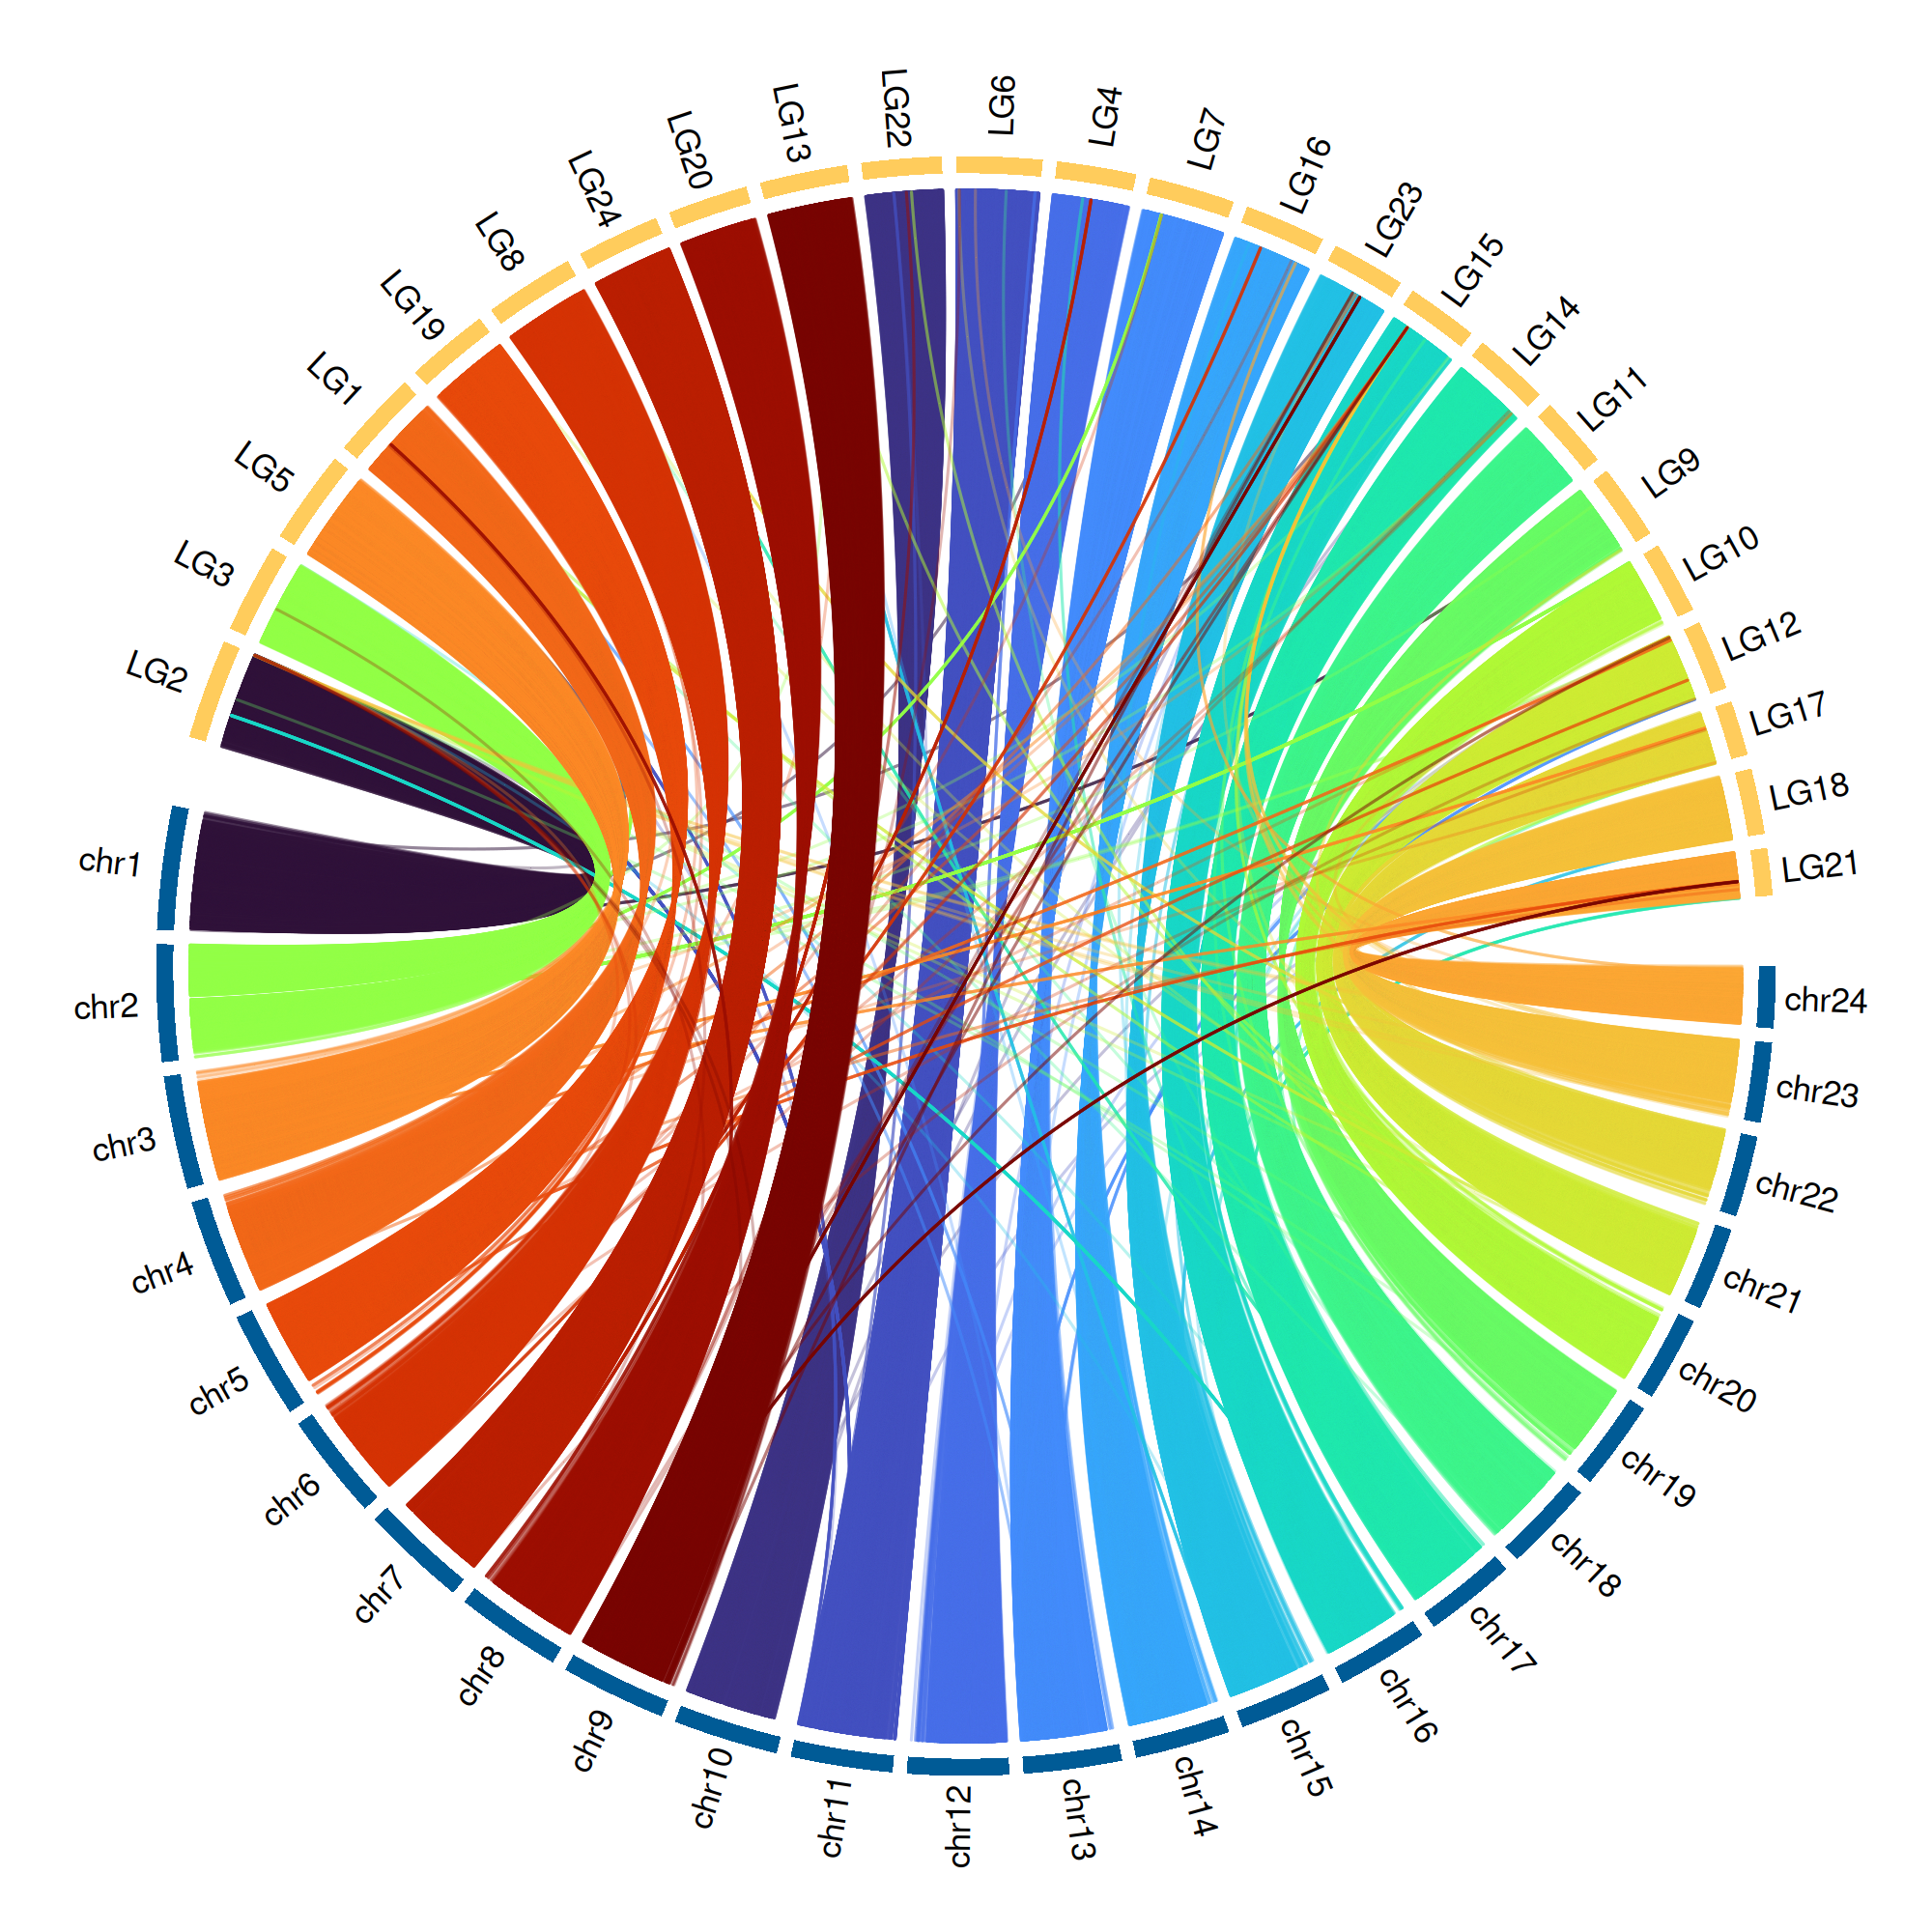
Is this big
Likes to do this
Likes to go here
Hates paprika
Nihilistic
Cyberbully

Slide 38

Appear

Slide 39
Appear

Slide 40

Appear

Slide 41
Appear

Slide 42

Push

Slide 43
Push

Slide 44
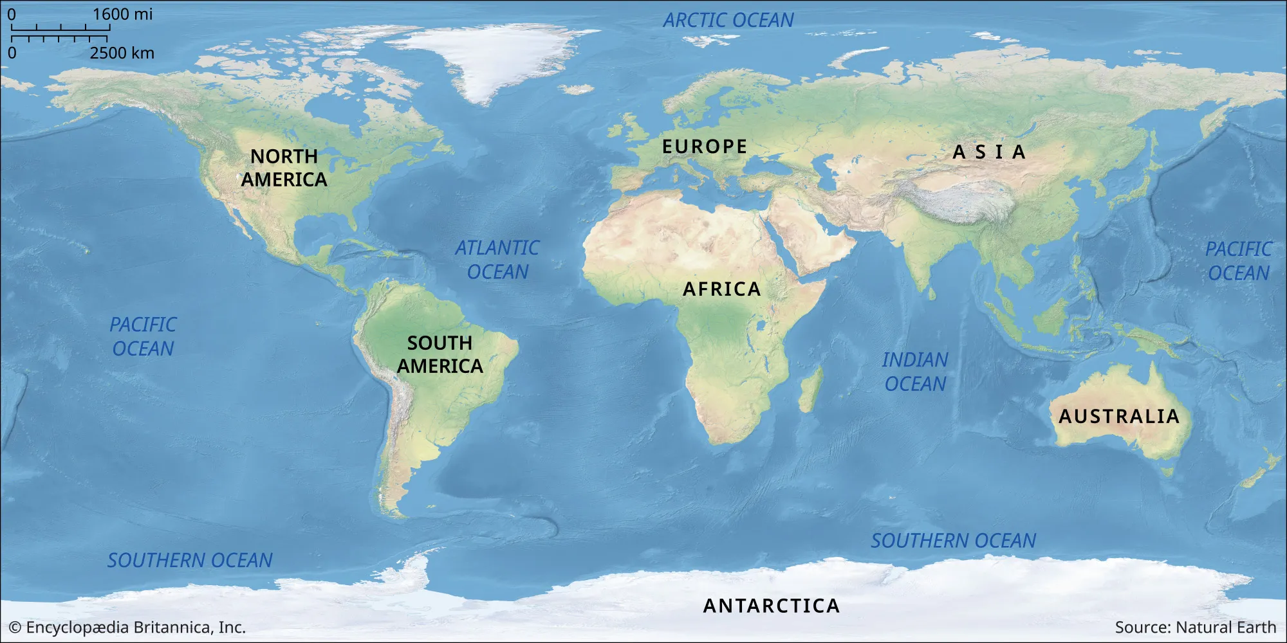
Image Pan

Slide 45
Image Pan

Slide 46
Image Pan

Slide 47
Image Pan

Slide 48
Exercise

Slide 49
5 Minute Break

Slide 50
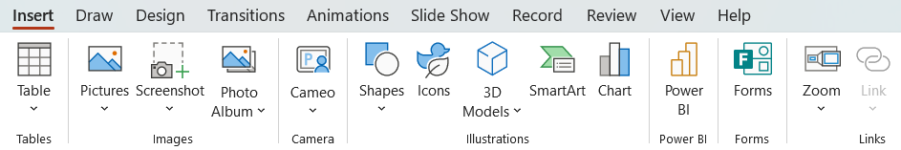
Zoom

Slide 51
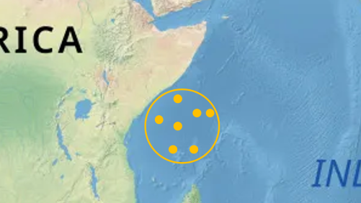
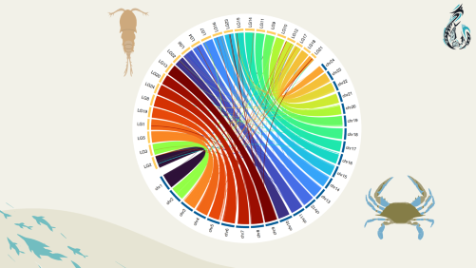
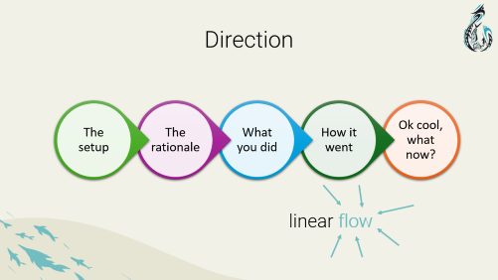



Zoom

Slide 52
Exercise

Slide 53
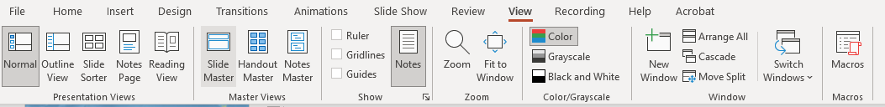
Slide Master

Slide 54
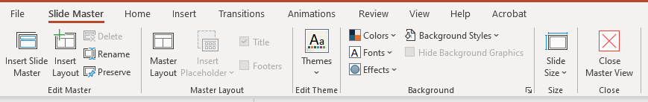

Slide 55
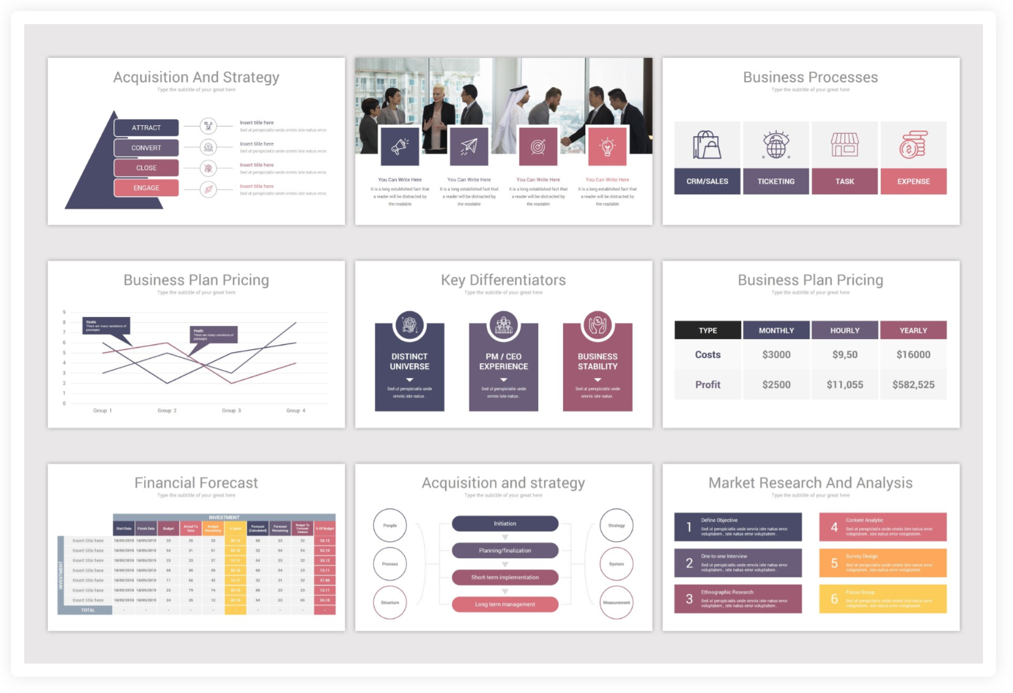
Think outside the classic layout

Slide 56
Exercise
Notes:
Make a theme with slide master and have at least 4 different slide layouts

Slide 57
5 Minute Break

Slide 58
Important things are important

Slide 59
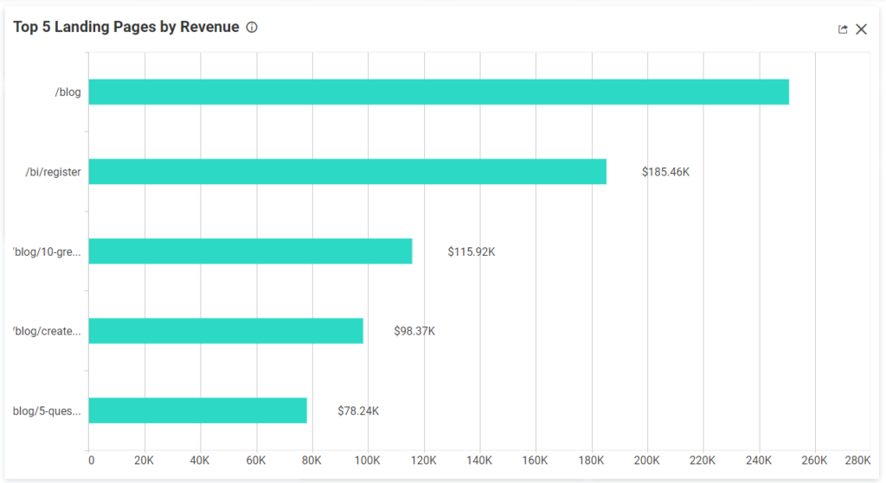
Highlight important things

Slide 60
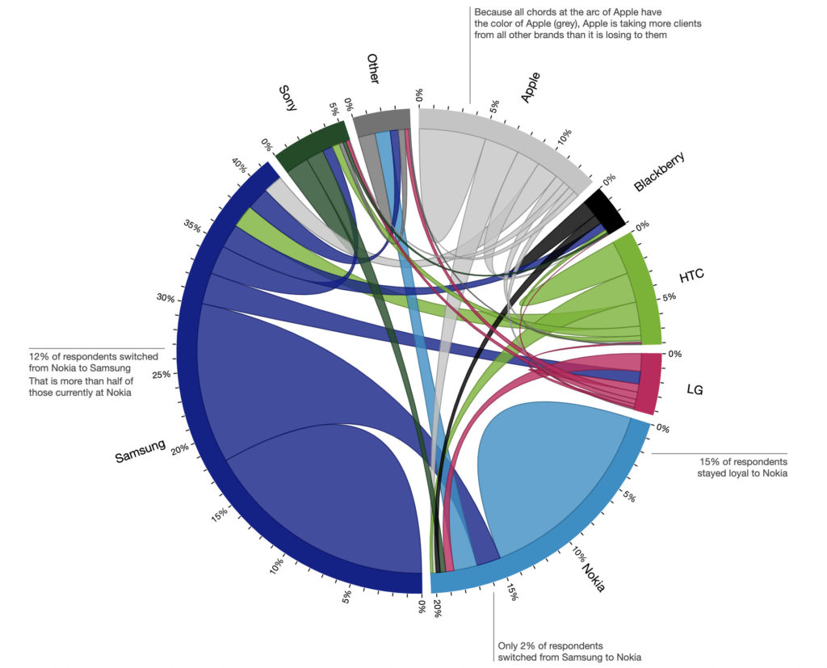
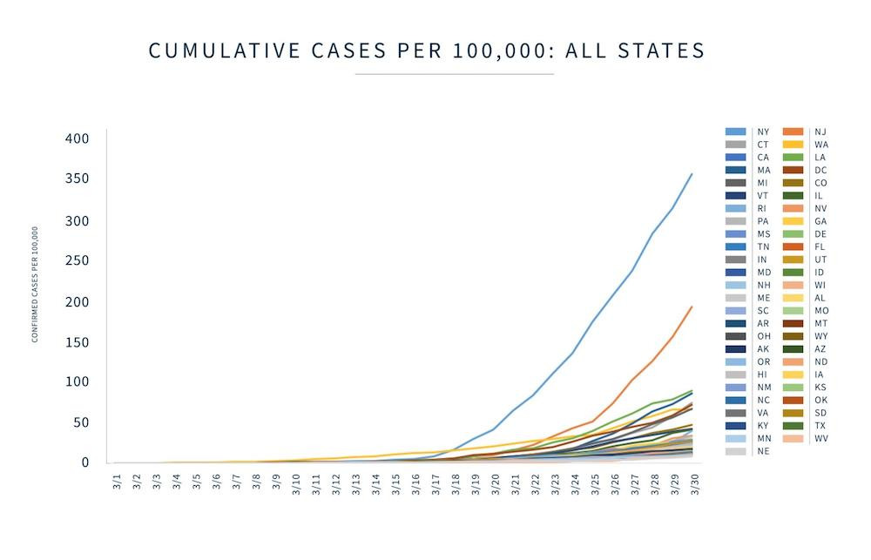
Title
some kind of text
more text about stuff

Slide 61
Title

Slide 62
Title

Slide 63
Title

Slide 64
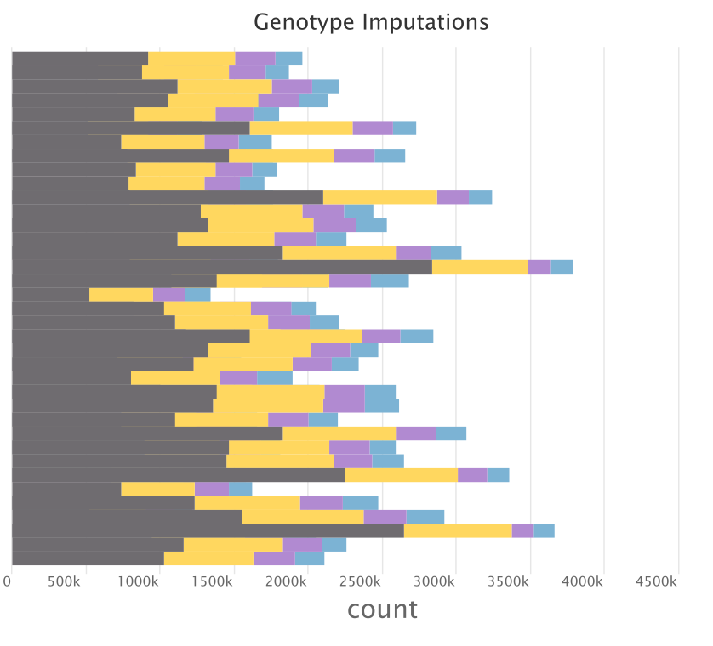
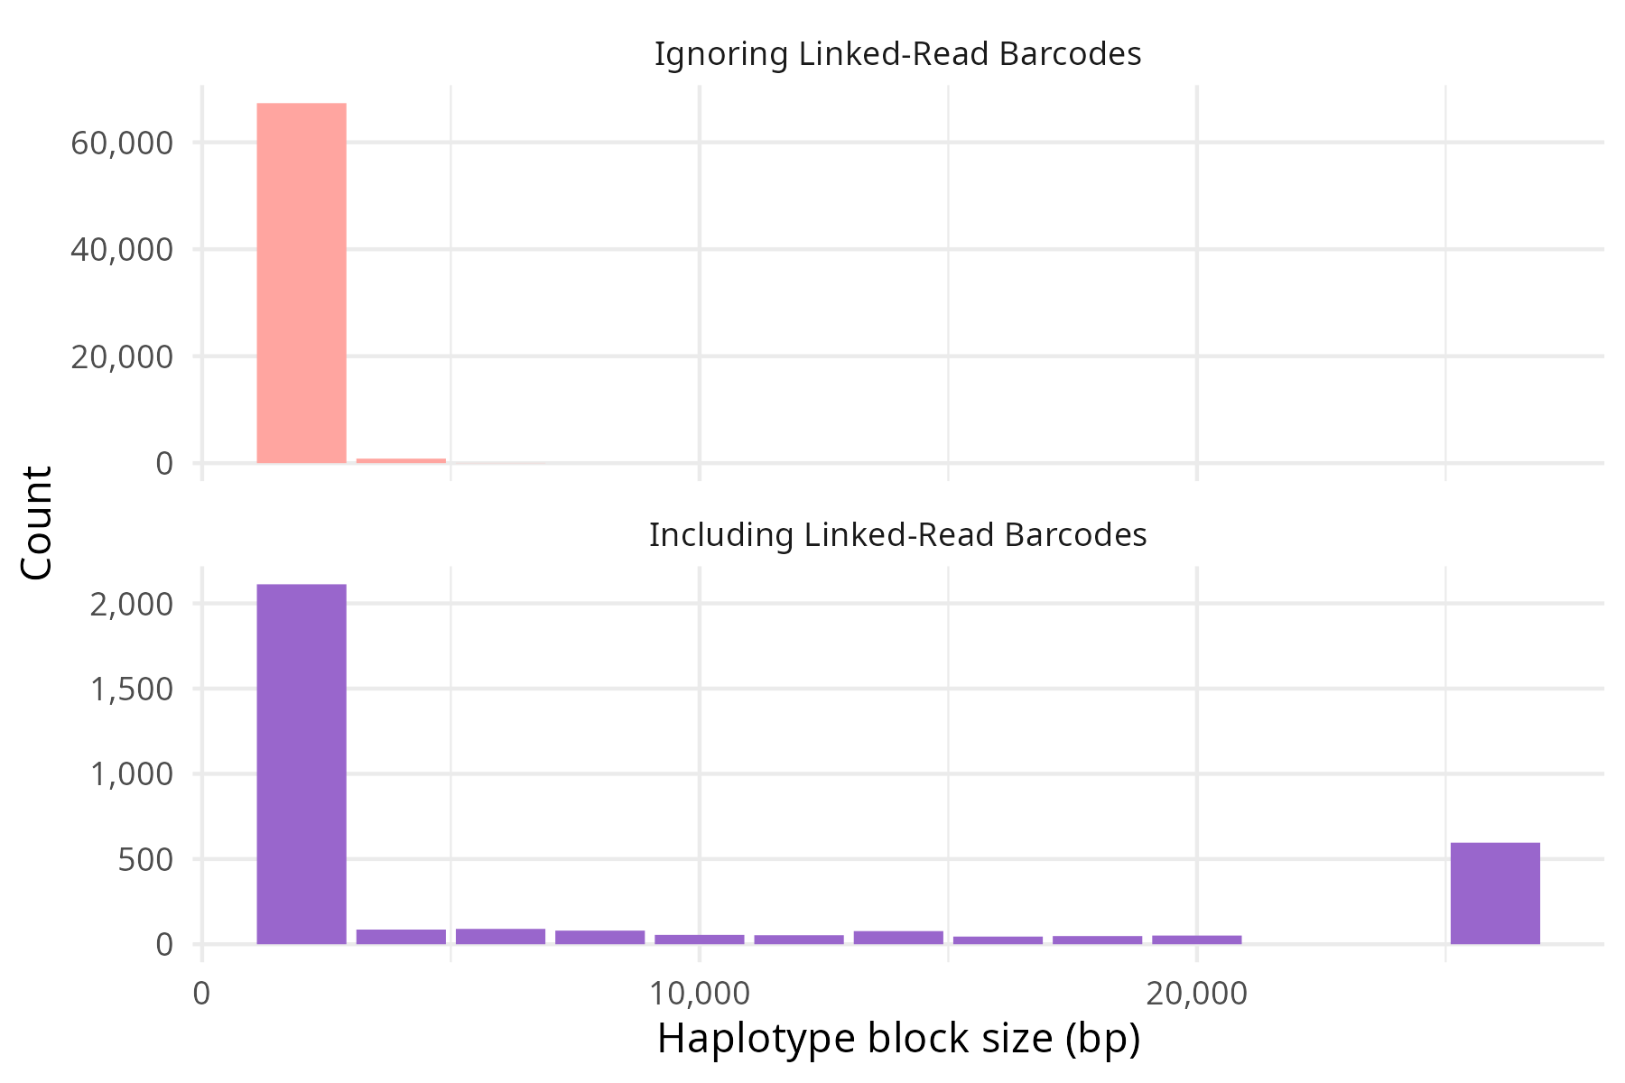
Recover many missing genotypes with linked-read aware imputation
Not Imputed
Hom Ref
Hom Alt
Het
called genotype
Phase SNPs into haplotypes
25kbp+

Slide 65
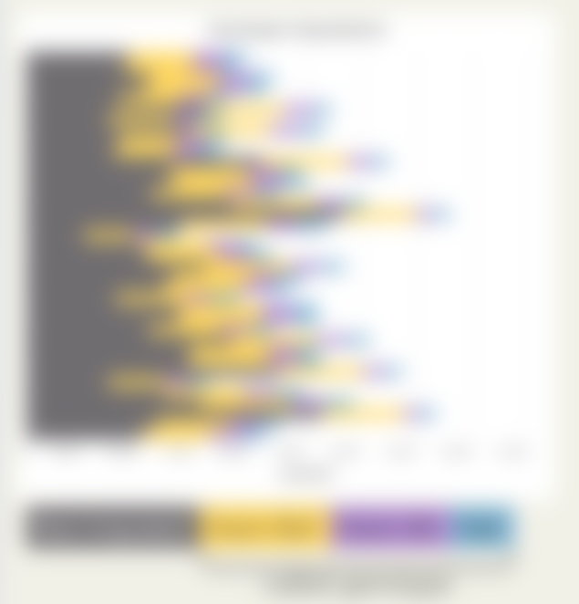
Recover many missing genotypes with linked-read aware imputation
Phase SNPs into haplotypes
25kbp+
Not Imputed
Hom Ref
Hom Alt
Het
called genotype

Slide 66
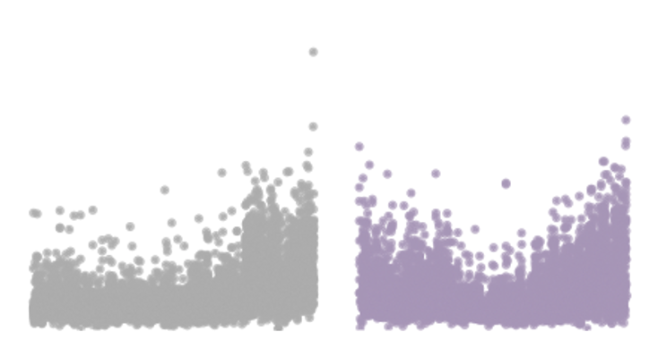
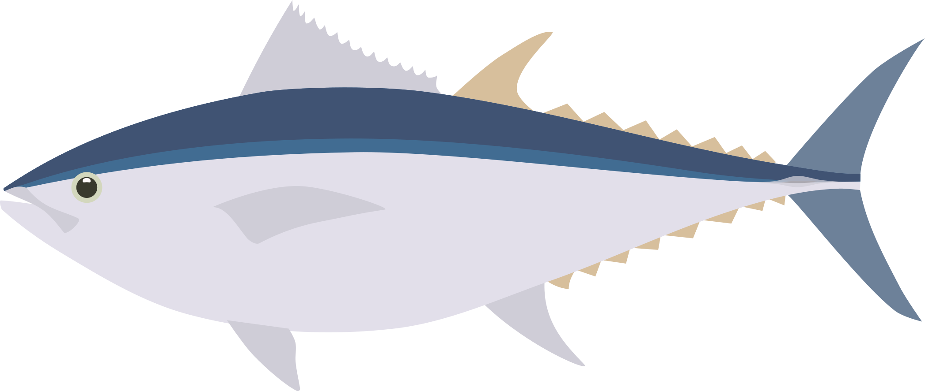

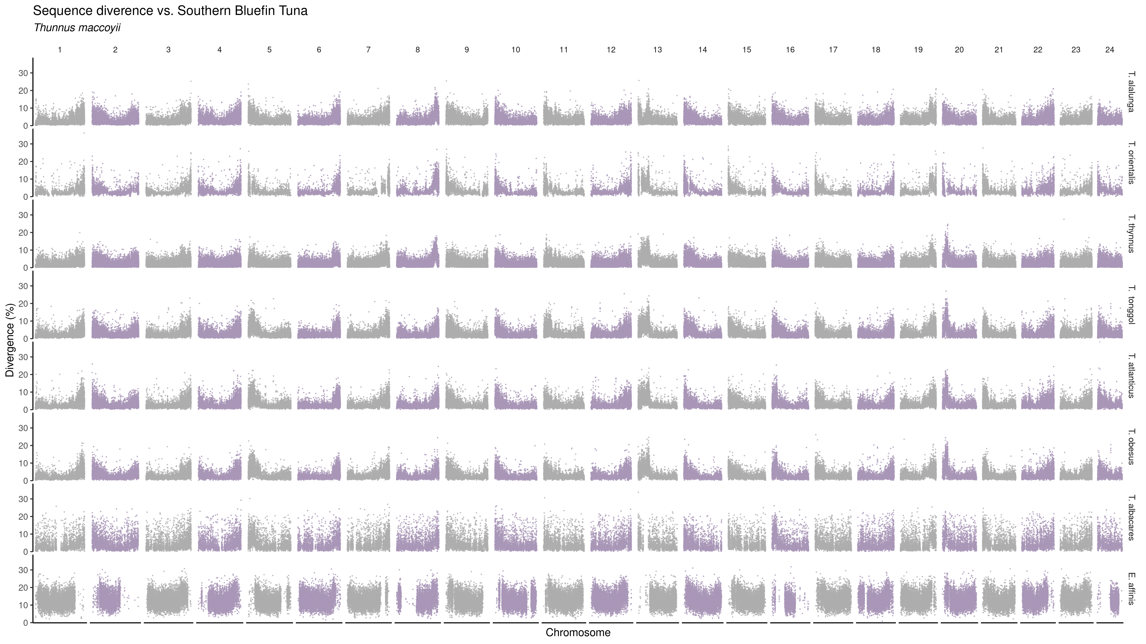
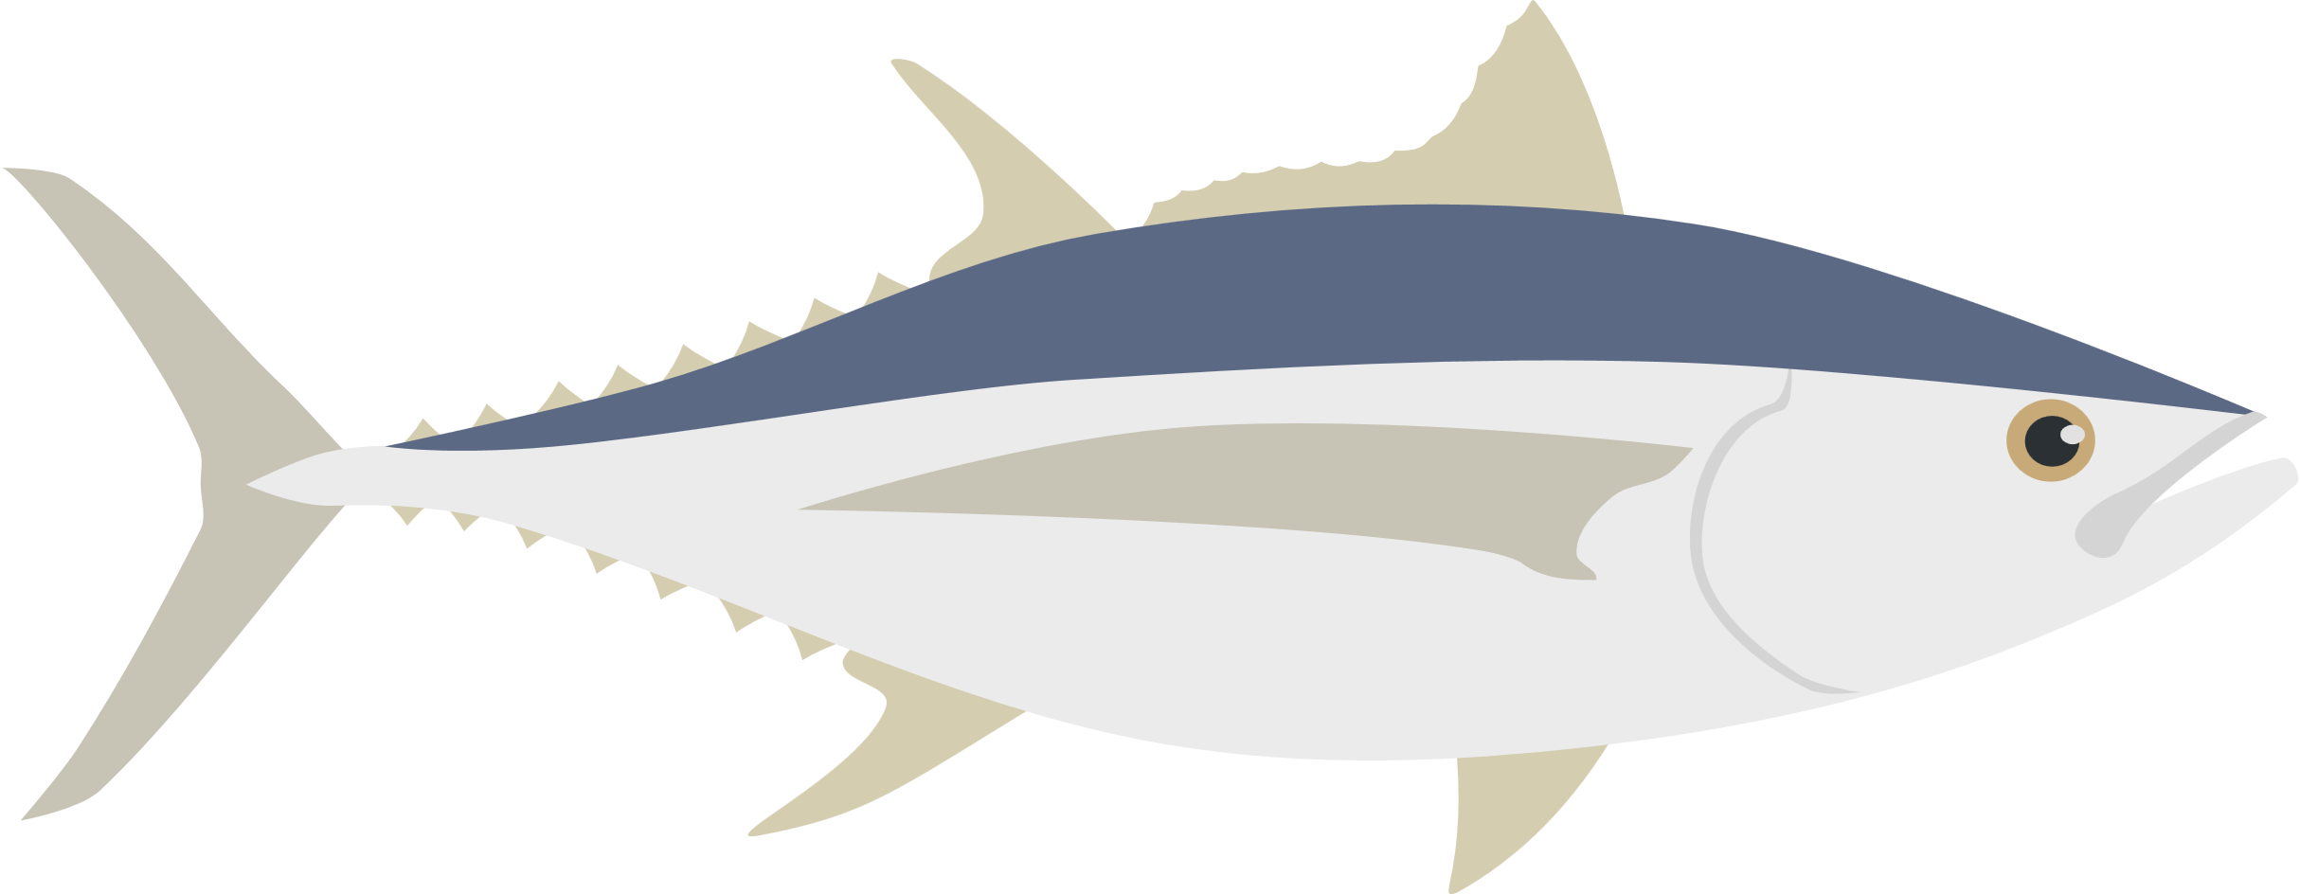

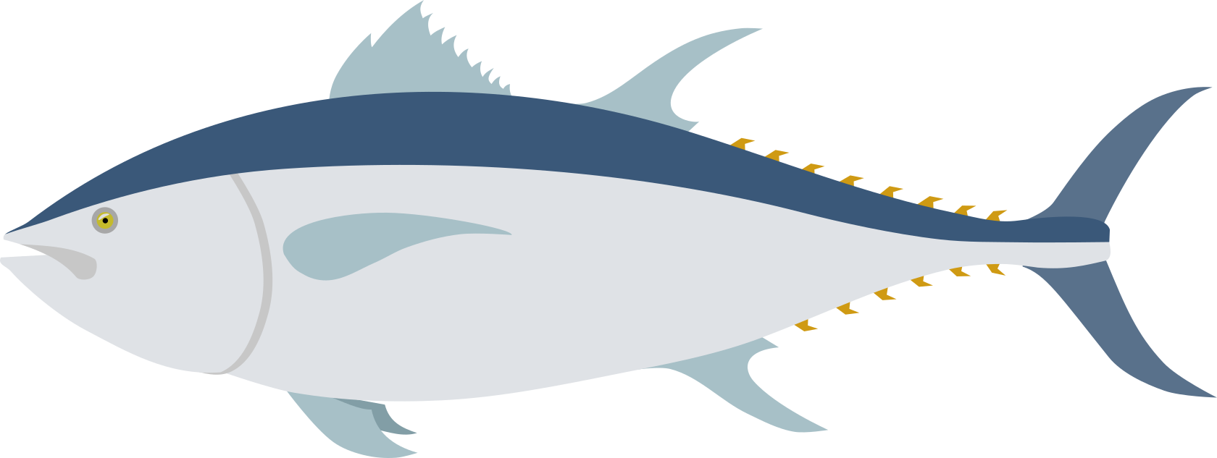


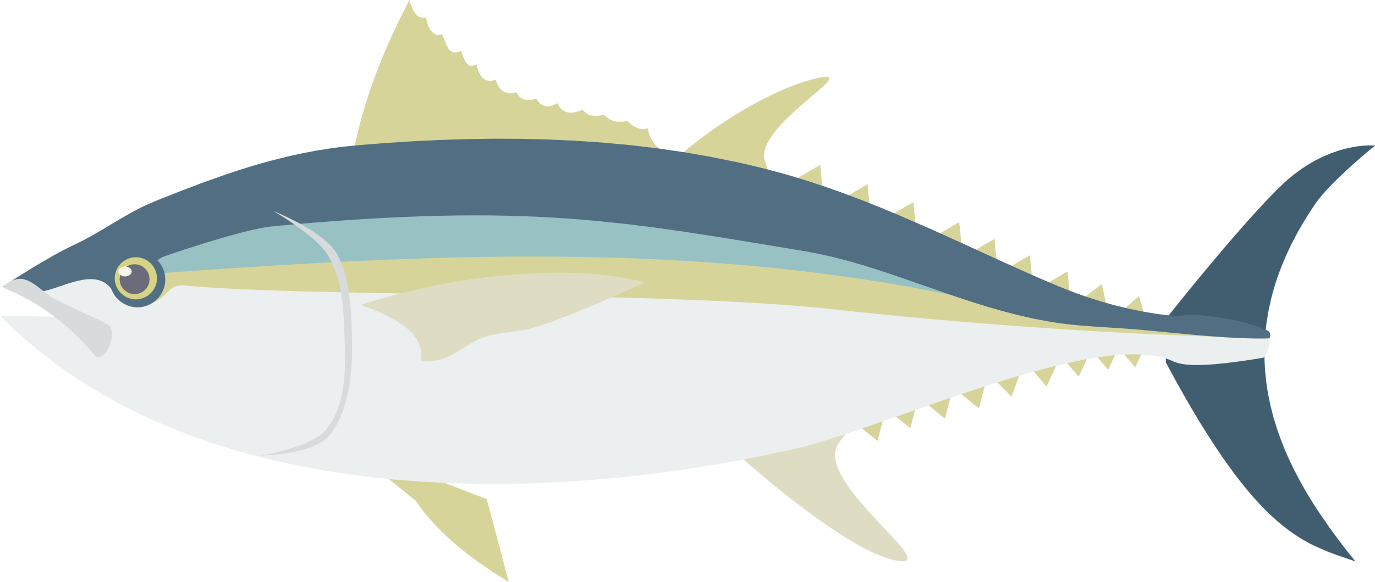


Sequence divergence vs Southern bluefin tuna
Marçaiset al. 2018
Notes:
relationship btwn species
conserved regions
confirm a tree

Slide 67
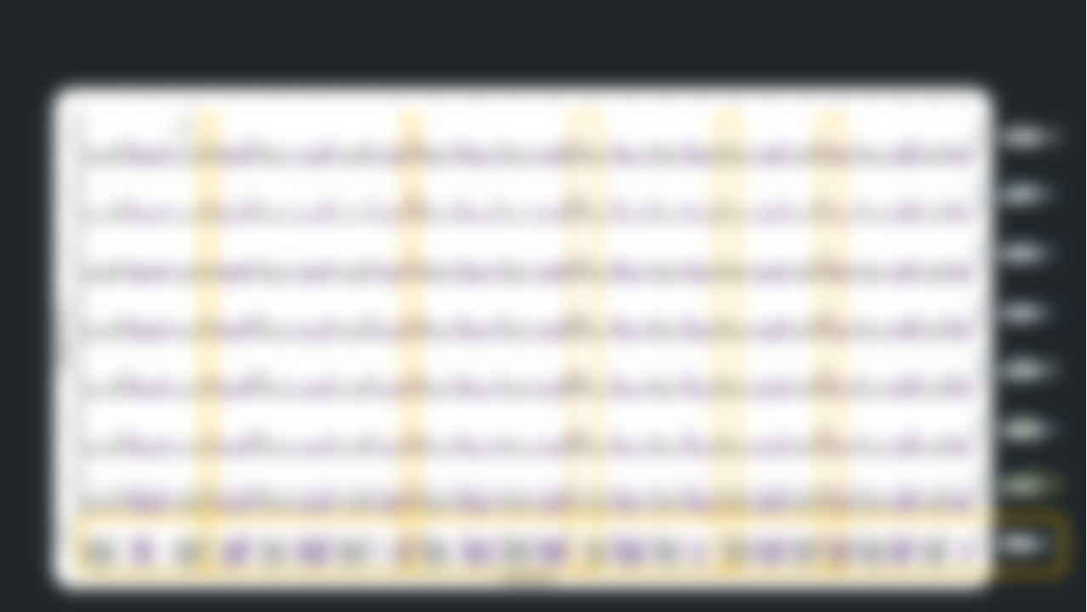
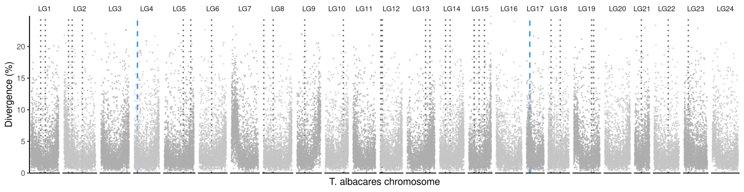




Sequence divergence vs Southern bluefin tuna
Sequence divergence between Yellowfin and Blackfin tuna
Marçaiset al. 2018
Yellowfin tuna
Blackfin tuna
Notes:
relationship btwn species
conserved regions
confirm a tree

Slide 68

Sequence divergence vs Southern bluefin tuna
Sequence divergence between Yellowfin and Blackfin tuna
Marçaiset al. 2018
Centromere?
Telomere?
Notes:
relationship btwn species
conserved regions
confirm a tree

Slide 69
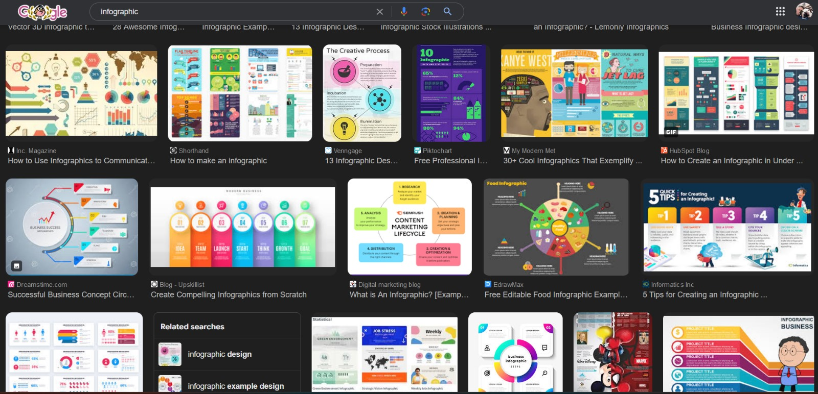
Look at what the pros are doing

Slide 70
5 Minute Break

Slide 71



Group Project
Fix these terrible presentations

Slide 72
Important abstract concepts
a.k.a Pavel’s soapbox

